Slide 1


Multi-Tenancy Architecture Lessons Learned
Bob Walker - Field CTO at Octopus Deploy
@bobjwalker
bob.walker@octopus.com

Slide 2
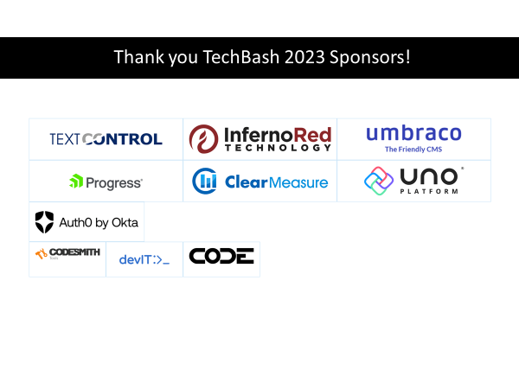

Slide 3

Bob Walker
Field CTO
Octonaut since 2018
@bobjwalker
bob.walker@octopus.com

Slide 4



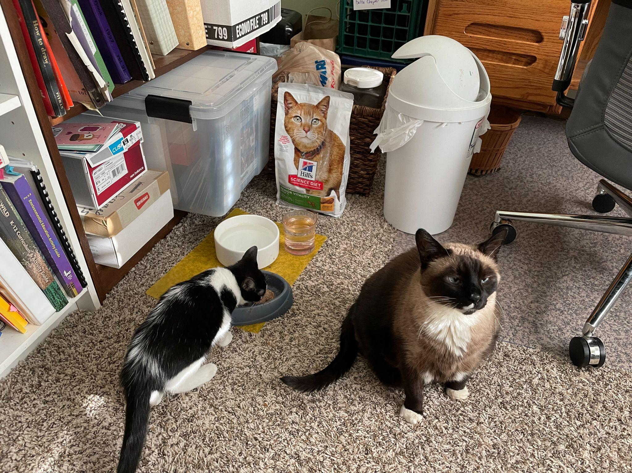

Slide 5







Slide 6


Slide 7
Outline
Multi-Tenancy Approaches
Single Website and DB
Single Website and Multiple DBs
Isolated Infrastructure
Multi-Tenancy Evolution

Slide 8
Multi-Tenancy Approaches

Slide 9
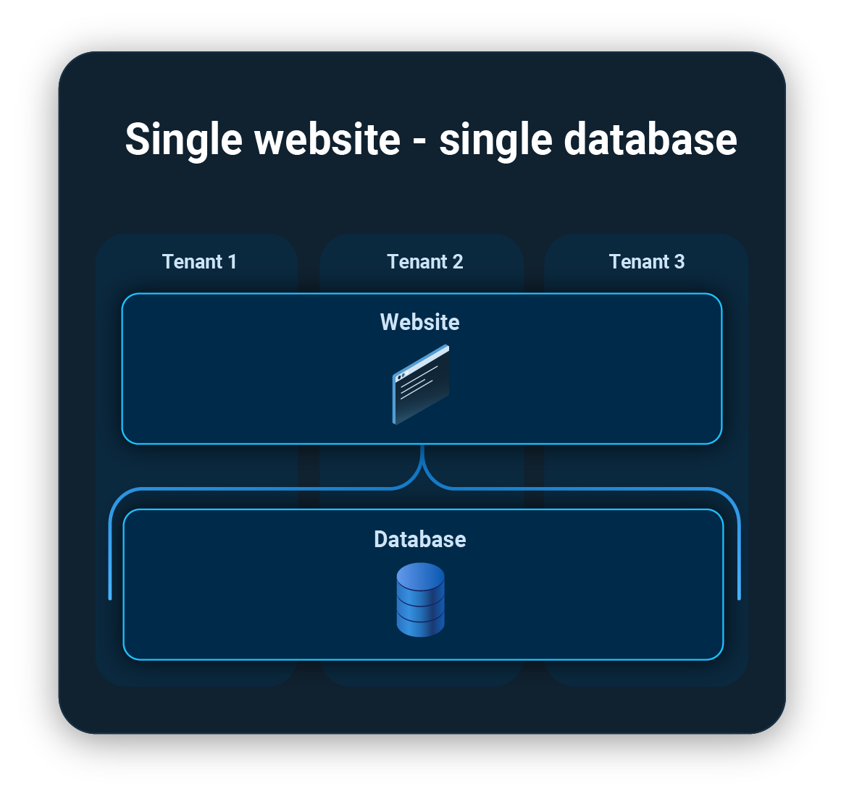
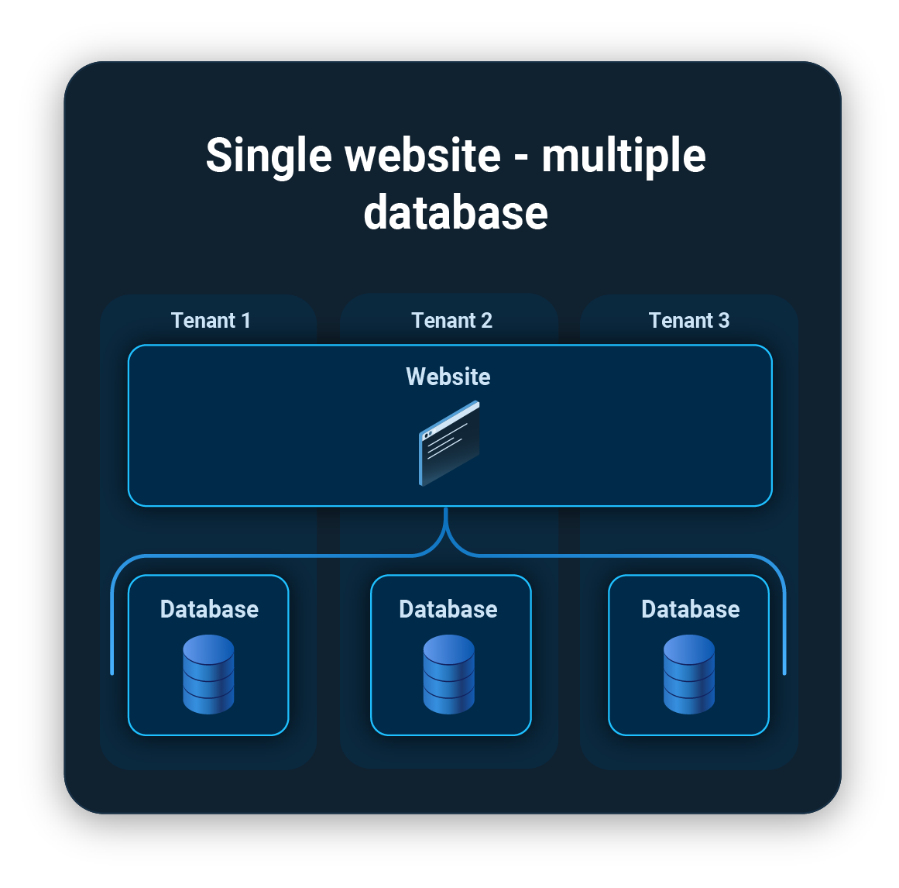
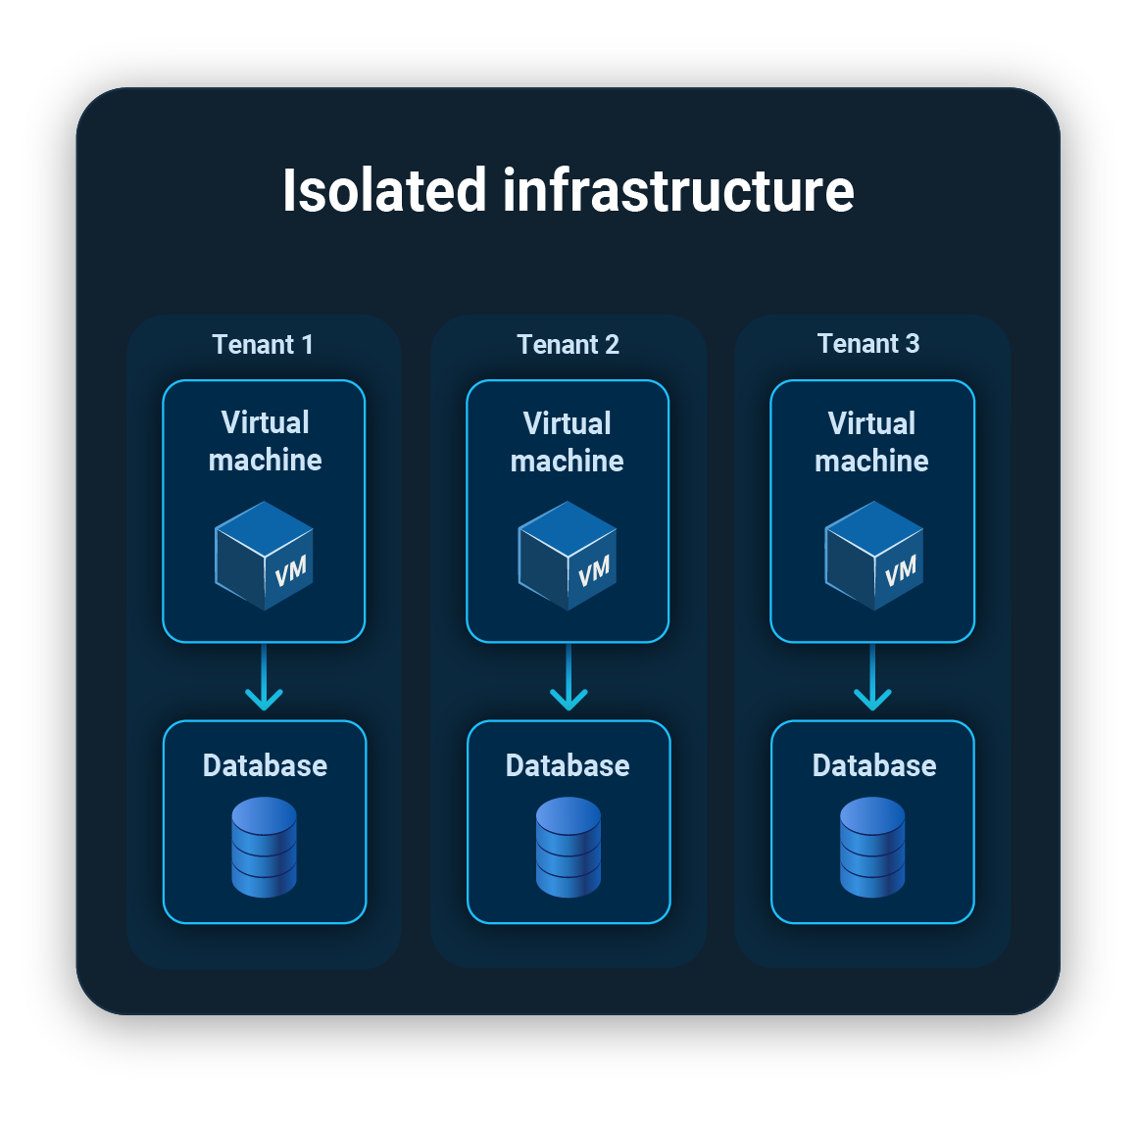
Approaches

Slide 10
Tenant Maintenance
How long it will take to add / remove / update a tenant along with the underlying platform costs.

Slide 11
Code Complexity
Code required to isolate tenants and users

Slide 12
Cross Talk
One tenant can access another tenant’s data

Slide 13
Noisy Neighbor
One tenant impacts another tenant

Slide 14
Deployment Time
How long a Production deployment takes

Slide 15
Contractual Complexity
Customer sign-off, data isolation, etc.

Slide 16



Comparing the three approaches
 | Isolated Infrastructure | Single Website / Multiple DB | Single Website / Single DB
Tenant Maintenance Risk
Code Complexity Risk
Cross Talk Risk
Noisy Neighbor Risk
Deployment Time Risk
Contractual Complexity Risk

Slide 17
Experience
 | Isolated Infrastructure | Single Website / Multiple DB | Single Website / Single DB
Sandhills Global | ✔
West Corporation |  | ✔
DTN |  |  | ✔
Farm Credit Services of America |  | ✔
ES&S | ✔ | ✔
Octopus Deploy | ✔

Slide 18
Single Website and DB

Slide 19
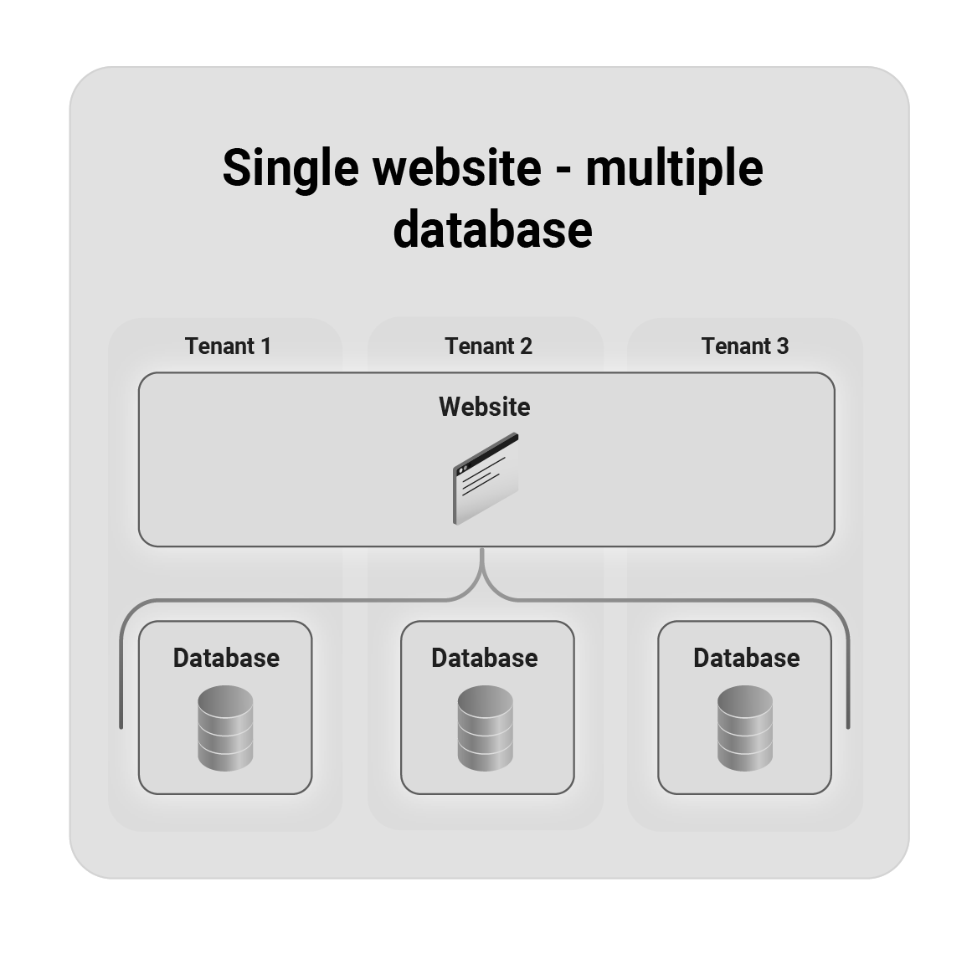
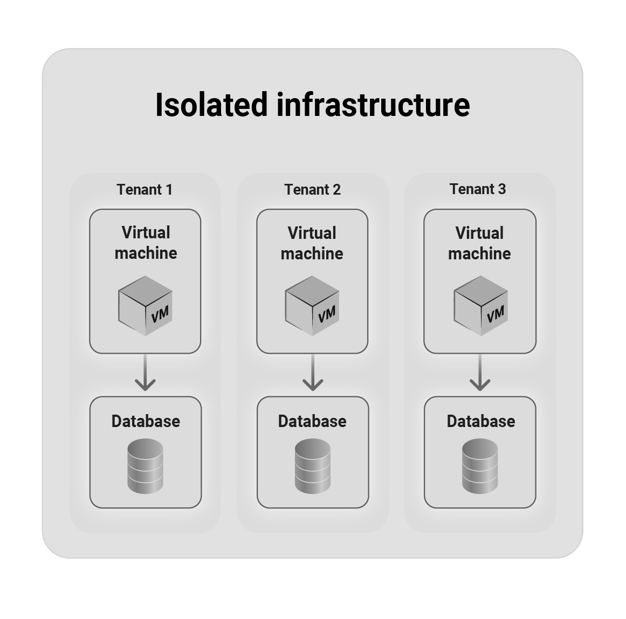
Single Website and DB

Slide 20
Tenant Maintenance Risk: Low
Add a record to a table in the database
Business rules to add tenant are in the same code base
Much easier for customers to “self-service”

Slide 21
Code Complexity Risk: High
“Where tenantId = [x]” for every query
Retrofitting multi-tenancy to existing application requires significant effort.
Significant effort to make authentication and authorization stable and secure.

Slide 22
Cross-Talk Risk: Medium
Missed queries
Forgot “Where TenantID = [x]”
Hardcoded TenantId during development
Security
User is assigned to wrong tenant
Avenue of attack
Typically found during testing
Fixing issues is typically easier, as everything is in one database

Slide 23
Noisy Neighbor Risk: High
All CPU / Memory / Database resources are shared.
One user from one tenant can impact all users across all tenants.

Slide 24
Deployment Time Risk: Low
One application and database to update
Update everyone at once
Single target for migration scripts

Slide 25
Contractual Complexity Risk: High
All tenants must sign-off before Production Deployment.
Disable functionality for customers who haven’t signed off via feature flags.
Data lives side by side with other tenants.

Slide 26
Single Website / Multiple DBs

Slide 27
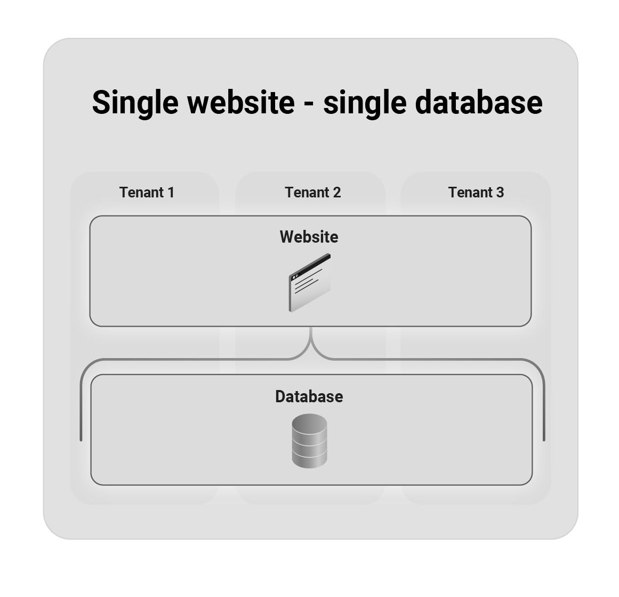
Isolated Infrastructure

Slide 28
Tenant Maintenance Risk: Medium
Creating new tenant involves creating a new database and connection string
Add the new database and connection string to connection manager
Self-service is not possible without automation.

Slide 29
Code Complexity Risk: Medium
No customer specific where clauses
Some code changes are required
Will require a “control database” to manage all the databases and connection strings.
Authentication and authorization must be perfect all day, every day

Slide 30
Cross-Talk Risk: High
Mechanism to authorize and authenticate user can still have bugs
More insidious to find, as it will occur at runtime with little warning.
Very difficult to fix, as it involves moving data between databases.

Slide 31
Noisy Neighbor Risk: Medium
Tenants share CPU / RAM resources
Tenants get isolated DB resources
A user on a tenant can consume all the CPU / RAM resources processing a request

Slide 32
Deployment Time Risk: High
Update 100s or 1000s of tenants.
Updates need to happen all at once, resulting in multi-hour deployments.
Likely a 5 AM Sunday deployment window due deployment time, time zones and traffic.

Slide 33
Contractual Complexity: Medium
Data is isolated from other tenants
Have to wait for majority of customers to sign-off before deploying
Feature flags might be required for hold-outs.

Slide 34
Isolated Infrastructure

Slide 35
Isolated Infrastructure

Slide 36
Tenant Maintenance Risk: High
Create new infrastructure for each tenant
Adding a tenant could take 10+ minutes
Need a platform or separate application with automation to add a tenant (which requires staff and time to create)

Slide 37
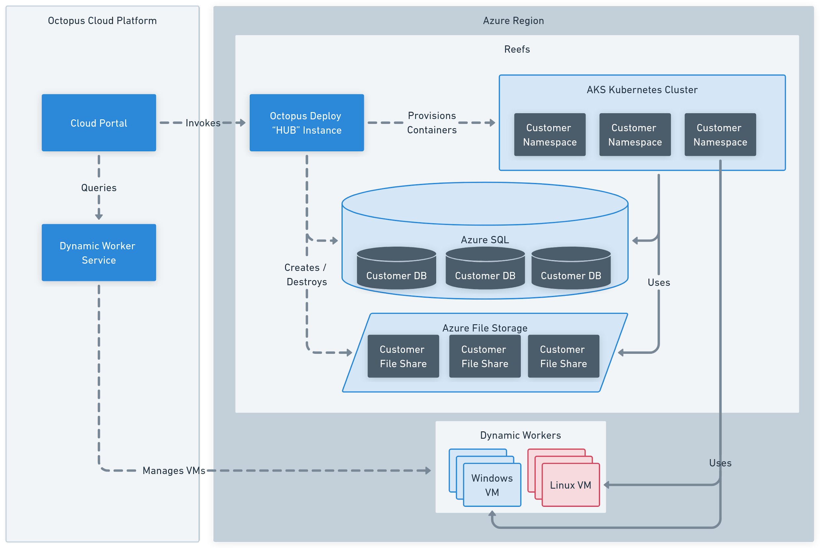
Octopus Deploy Cloud Platform
Notes:
The cloud platform is made up four key components, the reefs, the cloud portal, the hubs, and the dynamic workers.
The reefs are where customer’s Octopus Deploy instances are hosted. Each customer gets a container running in a dedicated namespace, a dedicated customer database, and a dedicated file share.
The instances are deployed to the reefs using the Octopus Deploy Hub Instance.
The cloud portal is responsible for managing the reefs. It invokes the Octopus Deploy hub instance to have it do deployments, provision / destroying infrastructure and more.
Dynamic workers are VMs used as delegates to deploy to K8s, databases, and PaaS. These VMs are provided on demand. The dynamic worker service manages the lifecycle of those workers

Slide 38
Code Complexity Risk: Low
No customer specific where clauses
Existing applications can be made multi-tenant with minimal effort.
Warning!!!! Temptation to “fork” the code base per customer - don’t!
Feature flags for tenant differences.

Slide 39
Cross-Talk Risk: Low
Each tenant has unique connection string and infrastructure.
No single place within the product code base to access all tenants.
If one tenant is compromised, it only impacts that one tenant.

Slide 40
Noisy Neighbor Risk: Low
Each tenant is provided with dedicated CPU / RAM / Database Resources
A tenant consuming all the resources has no impact on other tenants

Slide 41
Deployment Time Risk: Medium
Update 100s or 1000s of tenants’ instances
Individual tenant updates are generally fast
Can take days or weeks to update all tenants
Need to consider maintenance windows and time zones

Slide 42
Contractual Complexity Risk: Low
Deploy to each tenant as they sign off on the changes.
No need to add extra feature flags
Data is completely isolated.

Slide 43
Multi-Tenancy Evolution

Slide 44
Comparing the three approaches
 | Isolated Infrastructure | Single Website / Multiple DB | Single Website / Single DB
Tenant Maintenance Risk
Code Complexity Risk
Cross Talk Risk
Noisy Neighbor Risk
Deployment Time Risk
Contractual Complexity Risk

Slide 45
10 years ago
 | Isolated Infrastructure | Single Website / Multiple DB | Single Website / Single DB
Tenant Maintenance Risk
Code Complexity Risk
Cross Talk Risk
Noisy Neighbor Risk
Deployment Time Risk
Contractual Complexity Risk

Slide 46

Self-Managed Data Center Way of Thinking
Image Source: https://www.racksolutions.com/news/blog/how-many-servers-does-a-data-center-have/

Slide 47
Today
 | Isolated Infrastructure | Single Website / Multiple DB | Single Website / Single DB
Tenant Maintenance Risk
Code Complexity Risk
Cross Talk Risk
Noisy Neighbor Risk
Deployment Time Risk
Contractual Complexity Risk

Slide 48

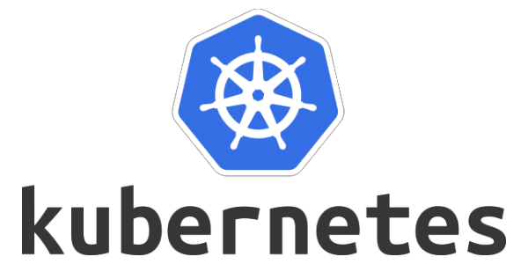
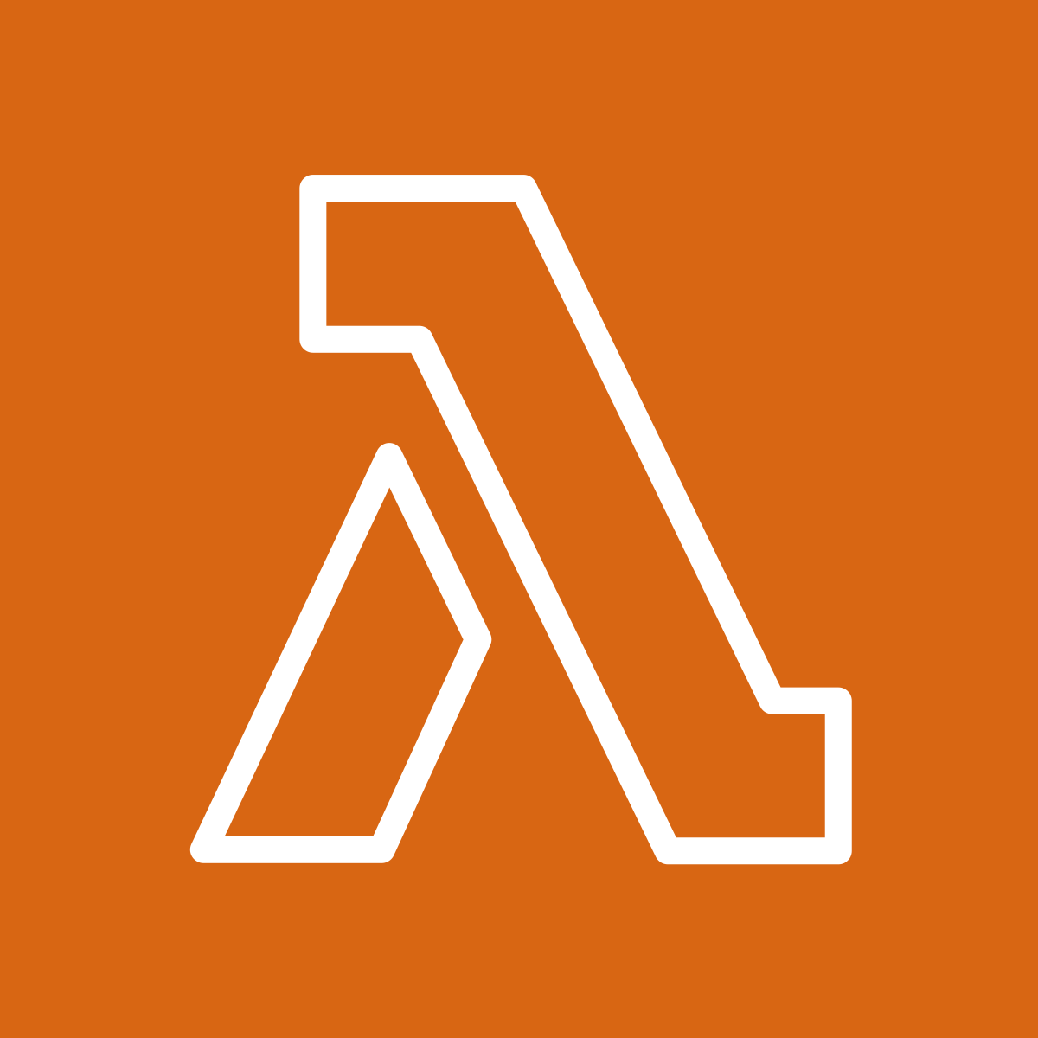
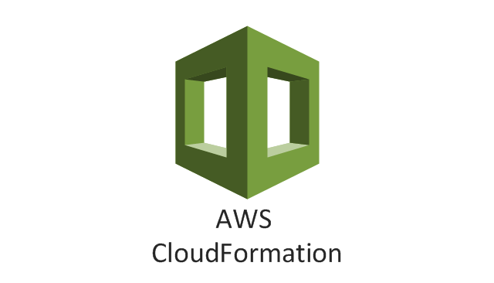
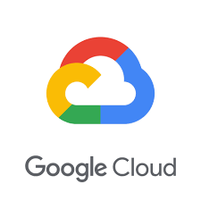
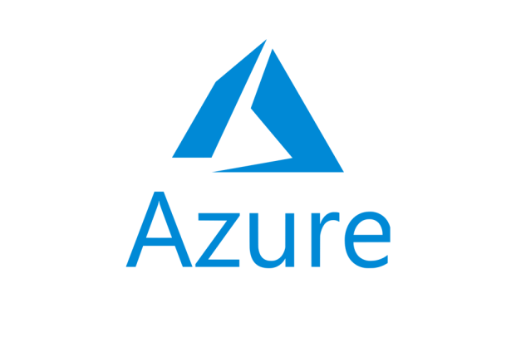
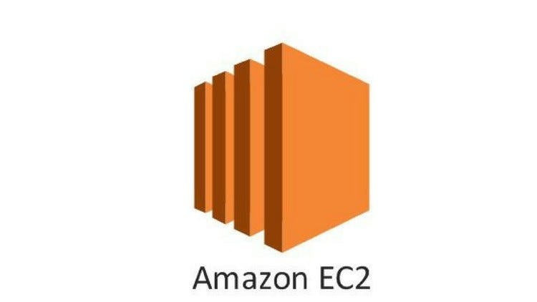
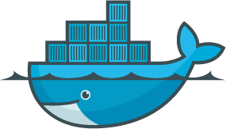
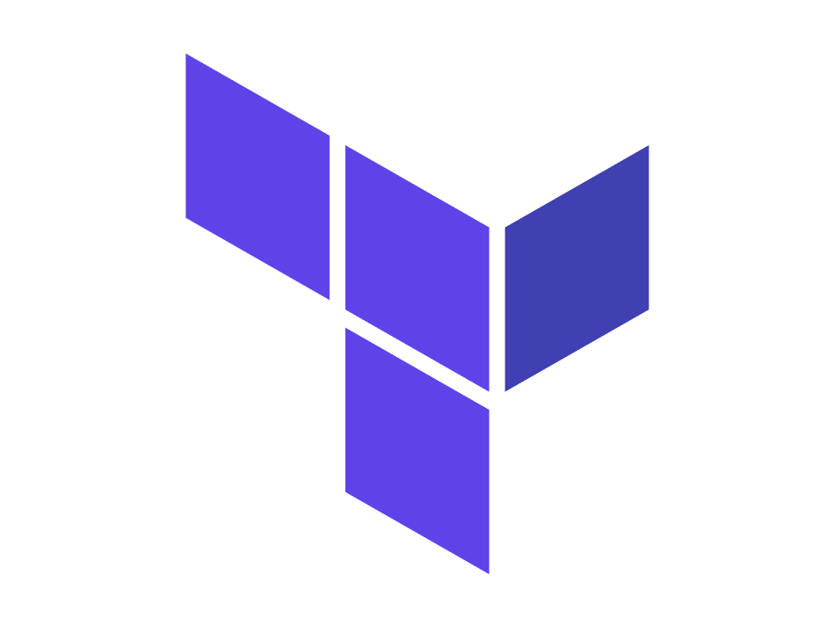
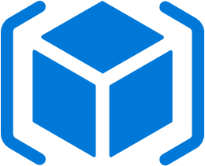

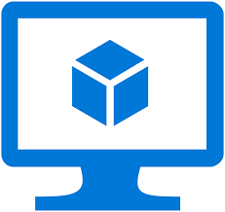

Slide 49
Critical: Invest in the underlying tenant management platform

Slide 50
Octopus Deploy Cloud Platform
Notes:
The cloud platform is made up four key components, the reefs, the cloud portal, the hubs, and the dynamic workers.
The reefs are where customer’s Octopus Deploy instances are hosted. Each customer gets a container running in a dedicated namespace, a dedicated customer database, and a dedicated file share.
The instances are deployed to the reefs using the Octopus Deploy Hub Instance.
The cloud portal is responsible for managing the reefs. It invokes the Octopus Deploy hub instance to have it do deployments, provision / destroying infrastructure and more.
Dynamic workers are VMs used as delegates to deploy to K8s, databases, and PaaS. These VMs are provided on demand. The dynamic worker service manages the lifecycle of those workers

Slide 51
Not all use cases are the same

Slide 52
Questions to Ask
Where should the multi-tenancy complexity live?
What external restrictions should you consider?
Contractual
Data Sovereignty
Application Hosts Location
What is your process to add a tenant?
Currently
Ideal state

Slide 53
Avoid Single Website - Multiple Databases
Worst of both worlds
Isolated Infrastructure
Build a tenant management system
Multiple databases to target for your database migration scripts
Long deployment times in one outage window when running at scale
Single Website / Single Database
Code complexity with all the various feature flags
Noisy Neighbors slow down other users
Sign-offs, if required, slow down deployments
Cross talk is more insidious and harder to test for

Slide 54


Thank you!
https://octopus.com/blog/benefits-isolated-tenanted-infrastructure
Bob Walker - Field CTO at Octopus Deploy
@bobjwalker
bob.walker@octopus.com
@bobjwalker

